Slide 1
Presentation Layer
Overview
DESIGN components
Mvc and mvp
Application security basics
Swapnil parashar

Slide 2
Presentation Layer - Overview
Contains components that display, implement UI and manage user interaction
UI Components: Visual elements used to accept user input and display info
Presentation Logic Components: Application code to define the apps logical behaviour and structure in a way that is independent of any specific UI implementation
When implementing the Separated Presentation Pattern, the logical components may include Presenter, Presentation Model and View Model components
May also include Presentation Layer Model components that encapsulate data from Business Layer, or Presentation Entity components that encapsulate business logic and data in a form that is easily consumable by the Presentation Layer

Slide 3
Presentation Layer - Components
Step 1 – UI Requirements
Identifying users, goals and tasks of the app. Info and its format required. User’s experience level. Responsiveness, graphical or animation support
Step 2 – UI Type
Rich Client Apps: Rich clients that are standalone apps – both online and offline
Rich Internet Apps (RIA): Rich web apps - dynamic, responsive e.g. media streaming
Web Apps: Web UI for different browsers / OS, standard web and web searchable
Step 2 – UI Type
Rich Client Apps: Mobile - Android, IOS, Windows
Rich Internet Apps (RIA): PhoneGap, Google Web Toolkit, Unity, Silverlight, Angular.js
Web Apps: Traditional frameworks and tools

Slide 4
Presentation Layer - Components
Step 4 – Design Presentation Components
UI Components:
Divide into discrete user controls to minimize complexity and allow reuse
Favour composition over inheritance and allow code reuse
Avoid creating custom controls if possible otherwise consider buying control toolkits
Presentation Logic Components:
Decouple processing from UI, store state related data, allow recovery and error free
Avoid UI specific, business logic, rules other than input and data validation
Presentation Model Components:
Represent data from business layer in a format easily consumable by UI
Easily bind to UI controls, MVC or MVP.
Presentation Entities:
Use these If data’s required format and behaviour differs from that of business entities
Encapsulate data from business logic, layer and ensure data consistency and validity
Data type – Custom Class, Array & Collection, DataSet & DataTable or XML

Slide 5
Presentation Layer - Components
Step 5 – Binding Requirements
Creates a link between UI and data or logic components.
Allows to interact with data from DB and other structures like Arrays & Collections.
Bridge between a Binding Target (UI control) and a Binding Source (data structure, model etc.)
One Way Binding:
Changes to Source property automatically update Target property but not vice-versa e.g. stock ticker.
Appropriate if binding control is implicitly read-only and if no need to monitor target
Two Way Binding:
Changes to Source or Target property automatically update each other
Appropriate for editable forms and fully interactive UI scenarios
Step 6 – Error Handling Strategy
Centralized exception handling, log exceptions, display user friendly messages, allow retry and display generic messages
Step 7 – Validation Strategy
Accept known good (Positive validation / Allow List)
Reject known bad (Negative validation/ Block List)
Sanitize

Slide 6
MVC & MVP – Model View Controller
Oldest pattern available for achieving separation of concerns
Model:
Input from controller and what data is needed to fulfil that request
Capable of doing transactions with DB or persistent storage if needed
After gathering required information, it informs View about new data by raising events
View:
Hosts all UI controls and monitors end user gestures to pass to controller for handling
Handles event notification received from Model and request for new data to render on screen
In some cases it only renders data received from view without processing. This is the case when Controller is designated to retrieve dataset from Model, format it and send it to View
Controller:
It is an extension to the View and handles all events originated from the View
Also informs Model on behalf of View that some event happened on View and some new data may be required

Slide 7
MVC & MVP – Model View Presenter
It is an evolved version of MVC.
In this pattern View receives UI events and calls the Presenter as needed.
Presenter is responsible for updating the View with the new data generated by the Model
Model:
As an interface to data.
Any data needed by any part of program needs to go through these this interface / functions predefined by the developer
Model houses all the data submitted by the end user
View:
It is the part where end user interacts and any program can have any number of Views
Its development can be designated to a special designer
Presenter:
Acts as intermediary to make decoupling possible
Contains all business logic for responding to a user event
Presenter is also responsible for retrieving the requested data from Model and format it so that View can render it without any overhead

Slide 8
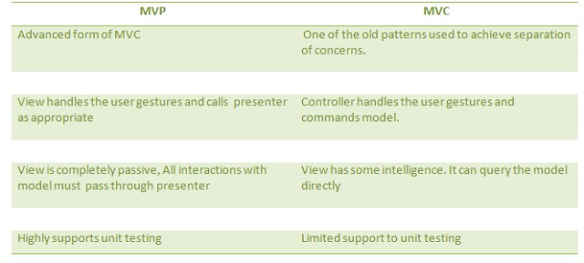
MVC and MVP

Slide 9
Application Security Basics
Large Spectrum of Applications
Multi-user e-commerce applications
Community applications – Wikis / CMS / Blogs
Custom built applications - Framework developed applications: Java SE, EE, PHP, Ruby, .NET
Exploits / Attacks
XSS / CSRF / SQL Injection
Large potential attack surface

Slide 10
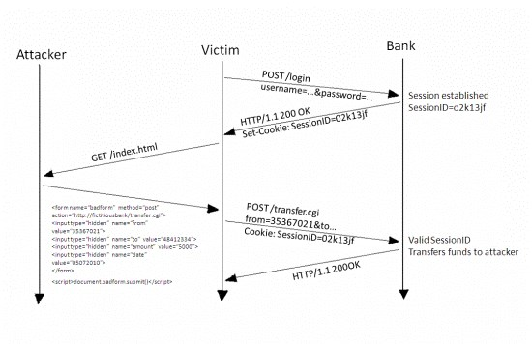
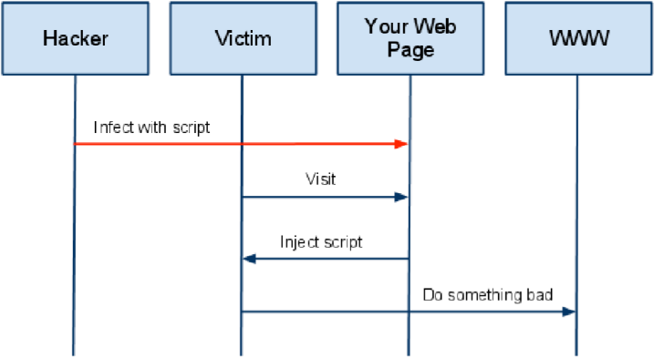
Application Security Basics
A High Level View of a typical CSRF Attack

Slide 11
Application Security Basics
ABC of Threat Modelling
Step 1: Identify Assets
Step 2: Identify Boundaries (Entry, Exit, Flows)
Step 3: Identify Controls

Slide 12
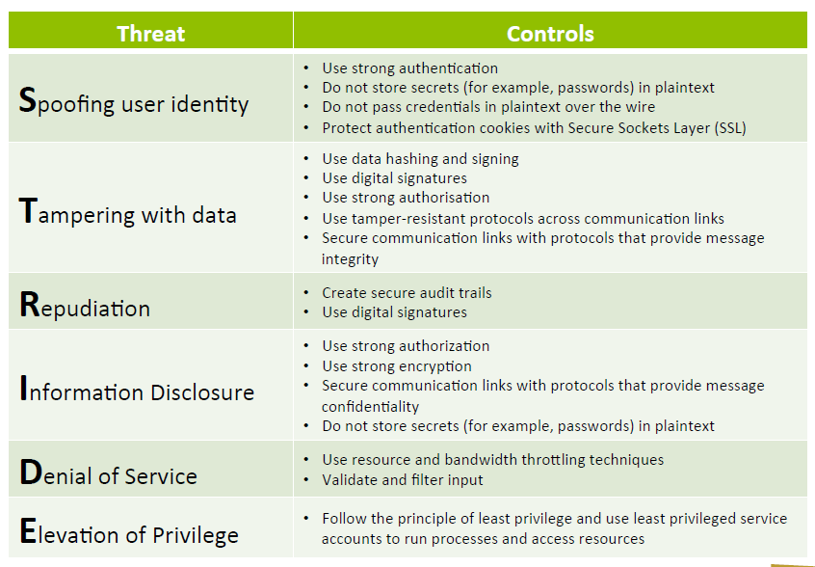
Application Security Basics: STRIDE

Slide 13
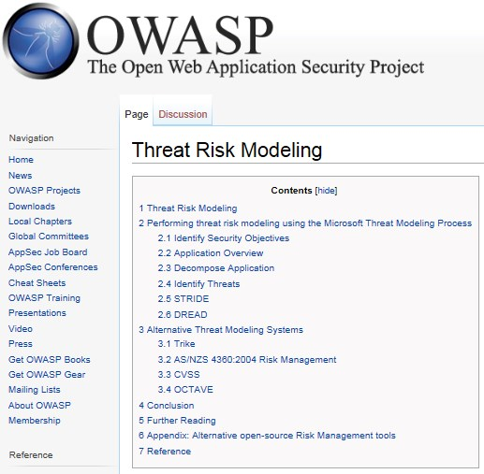
Other Models

Slide 14
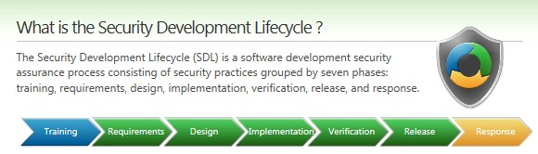
Security Development Life Cycle
Secure
Design
Security is an integral part of the
Secure
Security
Secure
development process
Release
Coding
Secure
From Cloud Security and
Testing
Privacy, Mather,
Kumaraswamy, Latif
Presentation Layer

